Slide 1
THE CONNECTED HOME
Encouraging Human Communication Through Technology

Slide 2
INITIAL BRAINSTORMING
“MY TWO HOMES”
PARENTS HOUSE “HOME”
Communication - MAinly VERBAL
4 PEOPLE-DIFFERENT ROOMS
TOILET/BATHROOM ROTAS/ROUtines
Boiling kettle/meal times to come together
SISTER/MUM/DAD FAMILY SPACE lIV|ING ROOM
Shouting tea is ready/shouting on each other
STUDENT FLAT “HOME”
Communication - Mixture of verbal/texting/
Facebook
FLATMATE x 1 (TAMARA, FEMALE)
SPOKEN, NOTES, ACTIONS - DOING DISHES FOR EACH OTHER/IF WE NEED ANYTHING FROM SHOPS/SHARED SPACE AND POSSESSIONS vegan/meateater (FOOD)
Cook separately/ say goodnight to each other
BOIL KETTLE IN MORNINGS AND SHOUT TO EACH OTHER IF WE WANT A CUP OF TEA
SIMILARITIES?

Slide 3
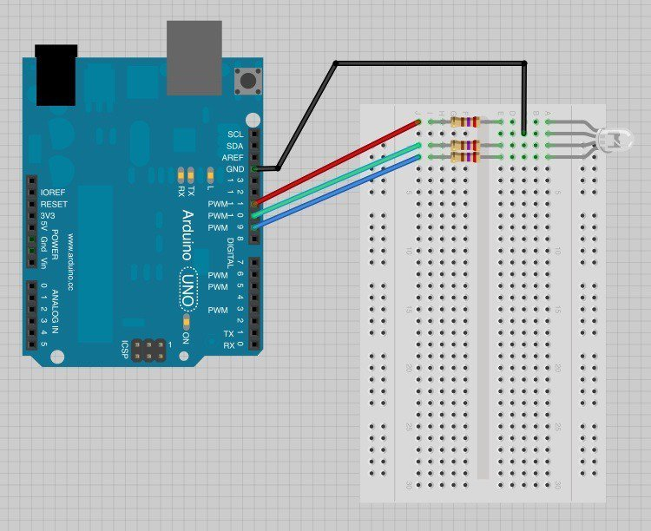
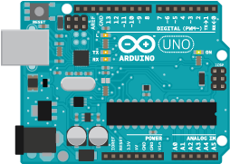
uSing arduino

Slide 4
WHAT IS ARDUINO?
AN open source platform of software and hardware that allows people who aren’t engineers (or particularly tech savvy) to create circuits or “SKETCHES” IN ORDER to CREATE DIGITAL DEVICES and interactive objects, tHat can sense AND control physical objects.
LIKE... TURNING ON LEDS/BLINKING LEDS/CONTROLLING BUZZERS/CHANGING THE PITCH OF BUZZERS/USING A BUTTON TO DETERMINE A SIGNAL/ reacting to light/reacting to temperature/turning motors on and off/gathering data from a potentiometer//running a sequence with variables/ETC

Slide 5
“You have to crawl before you can walk…”
WE PREFER TO
(DESIGN) SPRINT
USING ARDUINO TECHNOLOGY TO
TELL STORIES AND CREATE IDEAS...

Slide 6
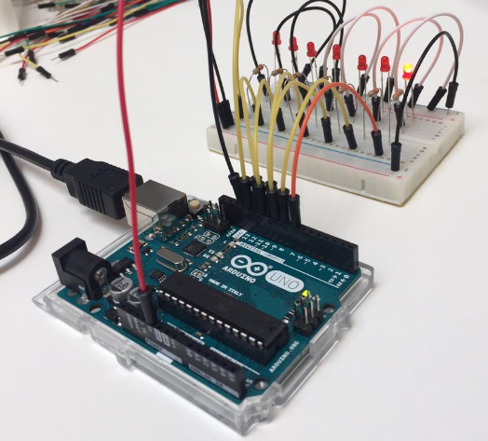
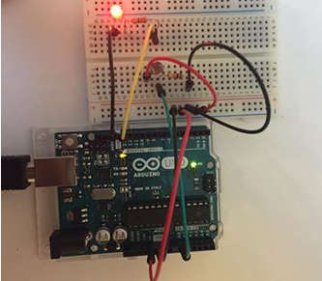
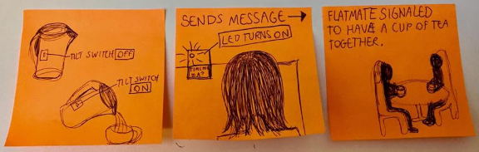
+
ARDUINO
STORY
=

Slide 7
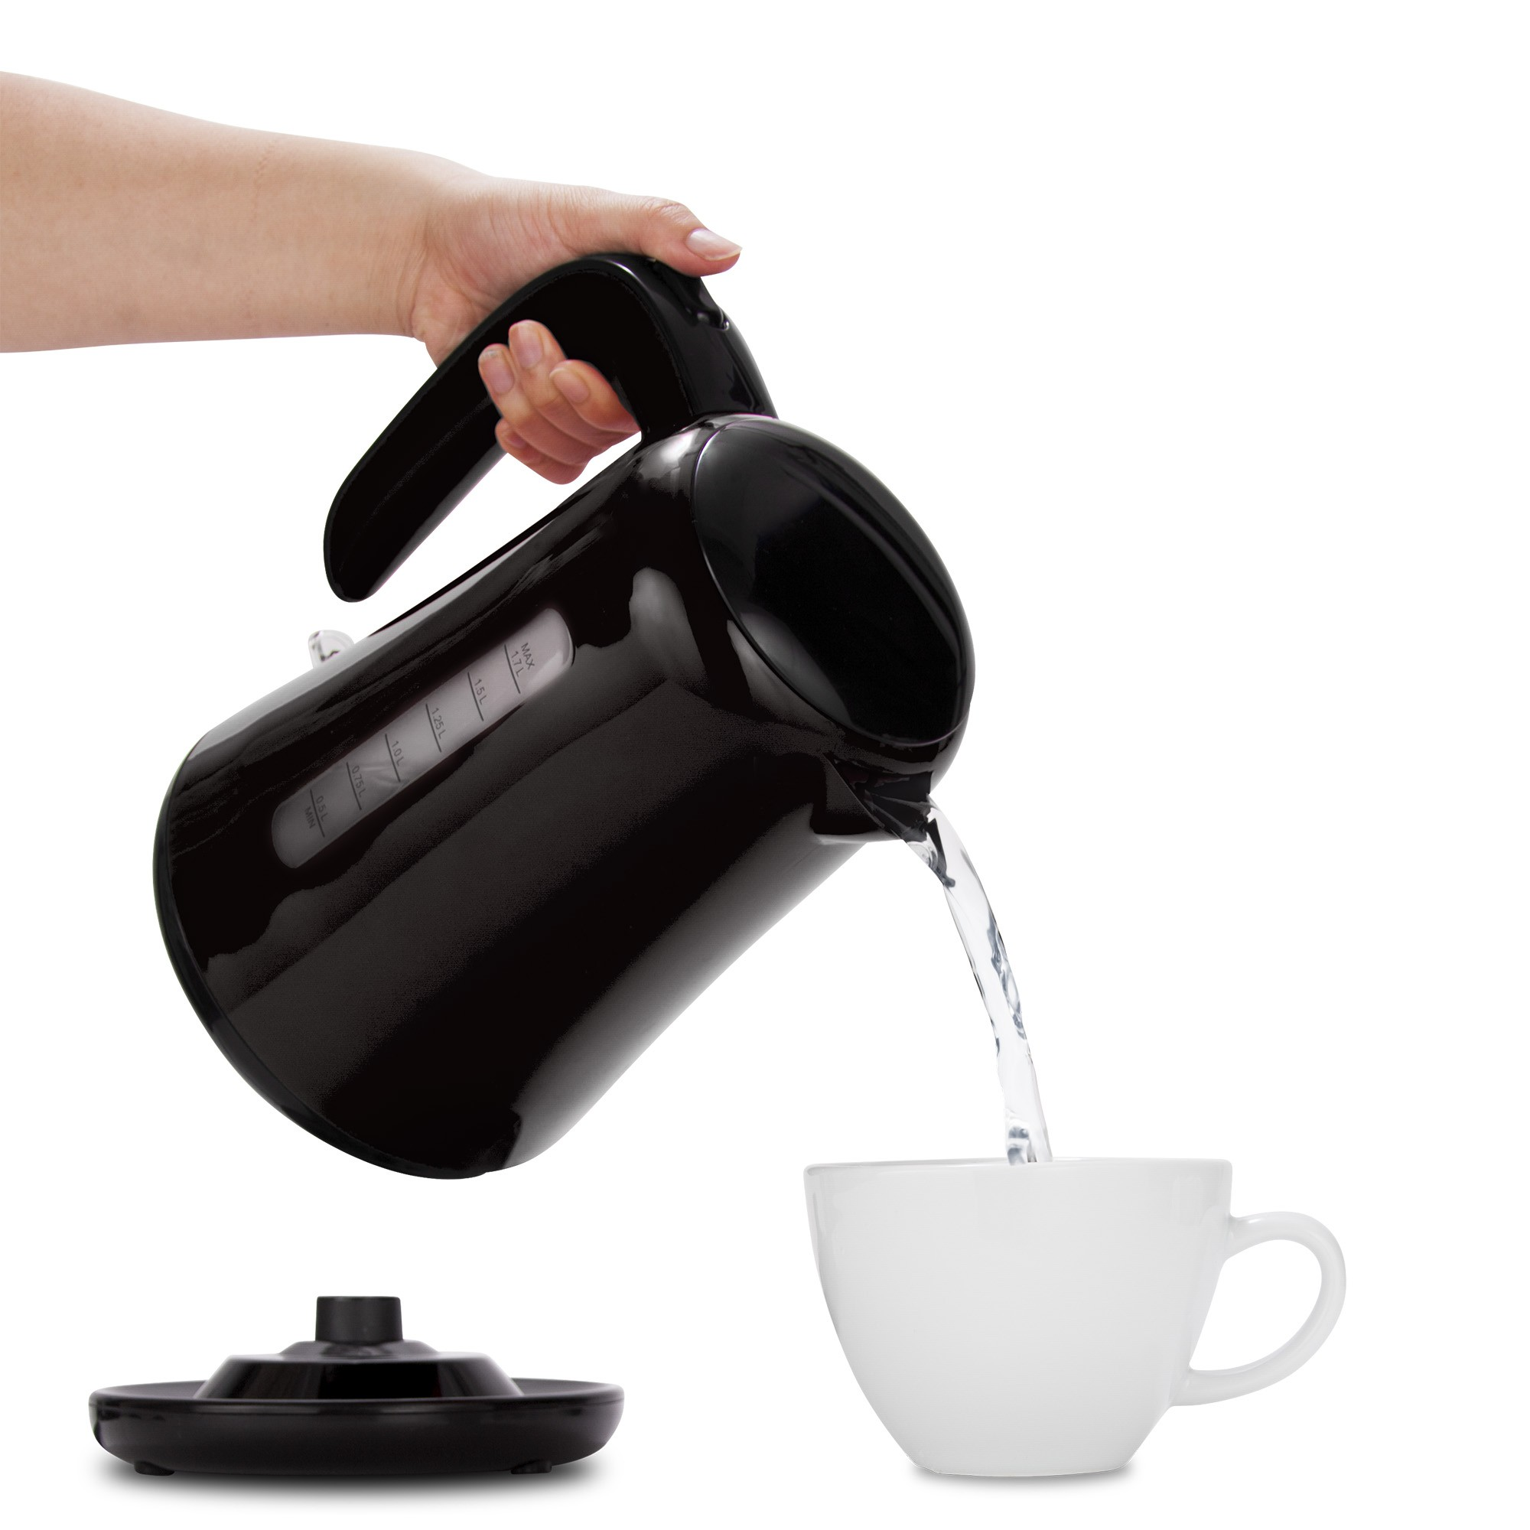
‘SOCIAL KETTLE’
A tilt switch located on kettle, when tilted lights an LED, to let one flatmate tell another that the kettle is being poured and they are making a cup of tea. To encourage social interaction and sharing stories using an event, like having a cup of tea.

Slide 8
THIS DESIGN SPRINT ALLOWED ME TO CREATE 9 SEPARATE IDEAS INSPIRED BY THE CONNECTED HOME.
MY PERSONAL FAVOURITE WAS THIS IDEA OF A PHYSICAL OBJECT BEING USED TO
BRING PEOPLE TOGETHER TO COMMUNICATE.
HOW DO I MAKE THIS IDEA BIGGER & BETTER?

Slide 9
FAMILY/FRIENDS/NEWS/ISSUES/ARGUMENTs/STORIES/CONVERSATIOn/FRIENDS/ENEMIES/CELEBRITIES/
DEBATES/HOW THEIR DAY waS/JOBS
/FINANCES/EMOTIONS/FEELINGS/
BELIEFS/RELIGION/ POLITICS
WHAT DO PEOPLE TALK ABOUT?

Slide 10
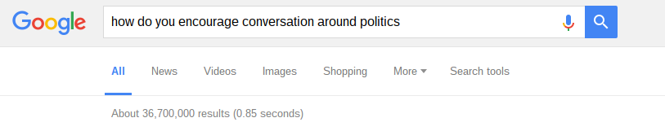
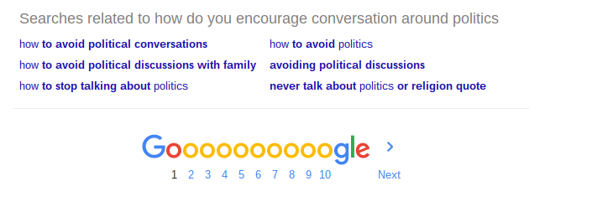

Slide 11
IT SEEMS LIKE,
PEOPLE DON’T WANT TO TALK POLITICS...

Slide 12
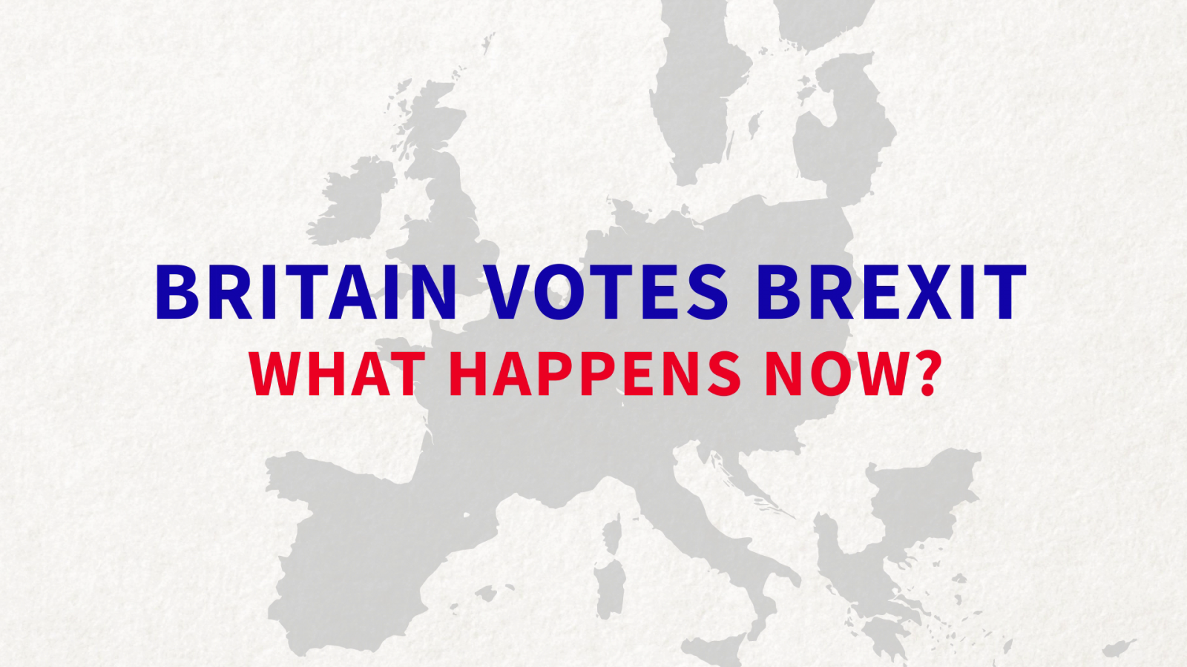

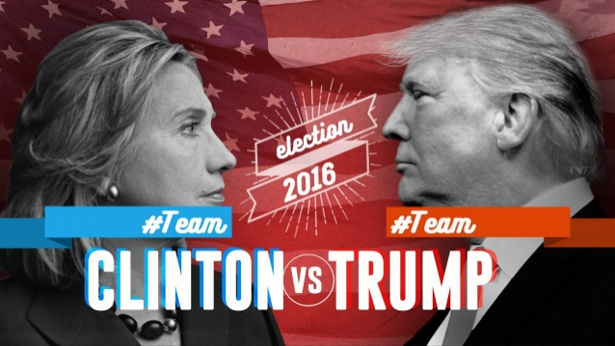
BUT EVERY DAY ‘POLITICS’ ARE RAPIDLY CHANGING THE WORLD WE LIVE IN
WE NEED TO TALK ABOUT THIS.
SO HOW DO WE GET PEOPLE TO TALK ABout it?

Slide 13

ONE IDEA WOULD BE TO ‘REMOVE THE FACE’ OF POLITICS.
“PEOPLE DON’T HATE POLITICS, THEY HATE POLITICIANS.”

Slide 14




HOW AND WHERE DO PEOPLE TALK ABOUT POLITICS?

Slide 15
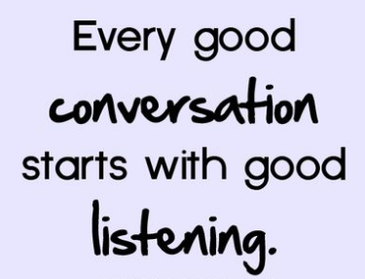
HOW DO YOU START A CONVERSATION AROUND POLITICS?
TOPIC + EVIDENCE/FACTS = DISCUSSION?

Slide 16
SOURCING ‘GOOD’ INFORMATION
NEWSPAPERS - HISTORICALLY BIAS AND SUPPORT CERTAIN PARTIES
NEWS COVERAGE - OFTEN BIAS/FOCUSES ON CERTAIN AREAS
SOCIAL MEDIA - LARGELY OPINION AND NOT FACT BASED/ANYONE CAN CONTRIBUTE WHICH HAS PROS AND CONS
“NEUTRAL POLITICS” - REDDIT BASED RRS FEED THAT FOCUSES ON EVIDENCE, LOGIC AND RESPECT.
“WIKINEWS” - MULTIPLE USER INPUT TO ALLOW COLLABORATION AND FEEDBACK
“THE REAL NEWS” + “VOTING COUNTS” OTHER ACCESSIBLE WEBSITE THAT USE RELIABLE FACT BASED SOURCES
NEEDS TO -
ENCOURAGE ENGAGEMENT
BE INFORMATIVE BUT NOT HAVE AN AGENDA
FACTUAL INFORMATION

Slide 17
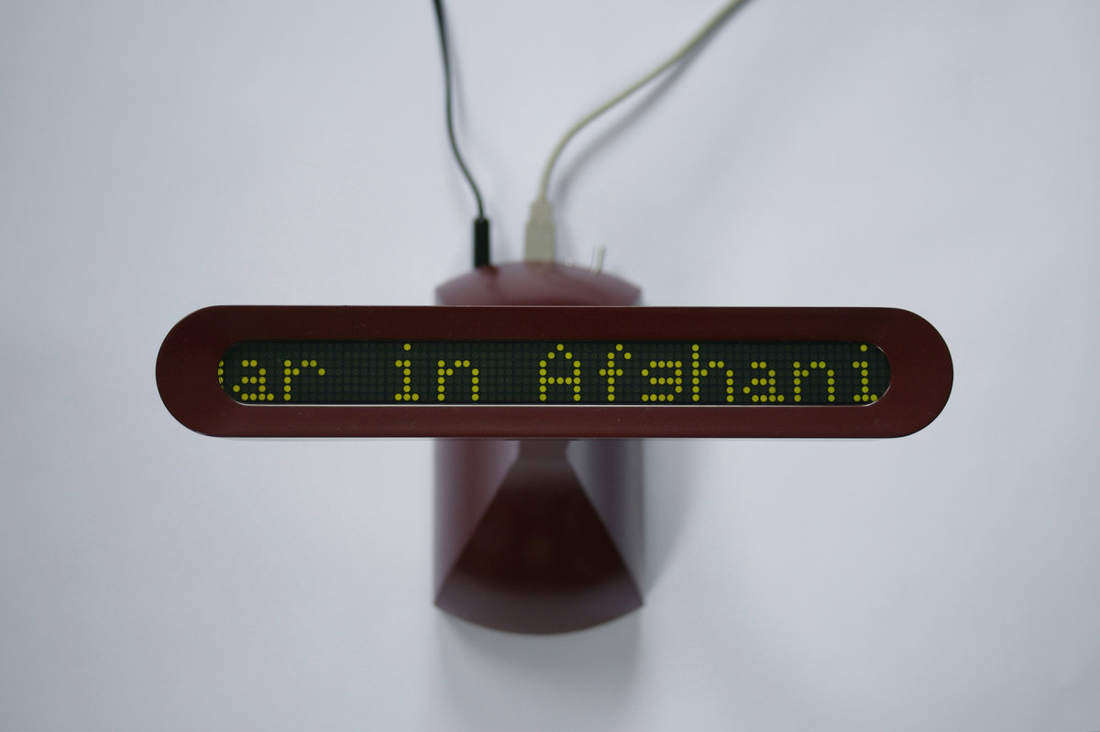

“PRAYER COMPANION”

Slide 18
“We chose 25 websites that published content as RSS feeds. Our choice was based on what we knew about the nuns and their interests. Some sites, such as BBC, CNN, Reuters and the New York Times, were chosen to represent the sources they already consult to inform prayer. But we also tried to ensure a broad international coverage with sites from South America, Australasia and Asia, as well as Europe and North America.
The point of using multiple, international RSS feeds was to counter media bias associated with any one source by exposing multiple voices”.

Slide 19
THIS IS AN EXAMPLE OF GOOD SOURCING
REMOVES BIAS BY USING MULTIPLE SOURCES
LINKED TO MEDIA THAT THE USER IS ALREADY FAMILIAR WITH - THIS CREATES A SENSE OF FAMILIARITY AND COMFORT WITH THE STYLE, NEWS AND LANGUAGE USED
COMBINES SOURCING-SELECTING-DISPLAYING (DEDICATED WEBSITE TO SELECT VARIED SOURCE MATERIAL AND REMOVE DUPLICATION, REMOVES SENTENCES LONGER THAN 8 WORDS AND THAT WON’T READ AS STATEMENTS ETC)

Slide 20
“Every five minutes, the Sourcing component chooses 10 sites from the list and retrieves their current RSS content. The software examines the headline field of each RSS item to see if it can serve as an effective digest of the news item and would read well scrolled across the Prayer Companion. Not all headlines are suitable. For example, some only make sense when read in conjunction with the attached story. Others are metaphorical or allude to the story content in some oblique way. We reject headlines longer than 8 words as too taxing to read on the Prayer Companion. To isolate headlines that most effectively serve as news digests we use natural language processing to identify headlines with a subject-verb-object structure. This is the syntax of simple declarative headlines such as ‘EU slaps tariffs on US biodiesel’ that are readable as complete sentences. All the headlines that satisfy our word length and syntactic criteria are automatically published on a webpage in a global-to-local ordered list. The number of items sourced in each iteration varies between about 20 and 70 depending on which sites are accessed. “

Slide 21
HOW DO I USE THIS STYLE OF SOURCING IN MY PROTOTYPE?
NEEDS MULTIPLE SOURCES:
AIM FOR 25+ WEBSITES RANGING FROM LOCAL NEWS TO INTERNATIONAL NEWS (AVOIDING DAILY MAIL, NEW STATESMAN, SOURCES WITH STRONG AGENDAS)
RRS NEWS FEEDS > LINK VIA ARDUINO TO LCD DISPLAY TO DEMONSTRATE FUNCTIONALITY IN THIS PROTOTYPING STAGE
(IDEALLY WOULD LIKE AUDIO VIA ARDUINO BUT SAW THE PRICE OF THE TECH NEEDED FOR THAT AND I HAVE NO HOUSE TO REMORTGAGE OR SPARE ORGANS RIGHT NOW)
“It was no longer the device itself which was being discussed but the content.”
Should my device be disruptive or blend into it’s environment?

Slide 22
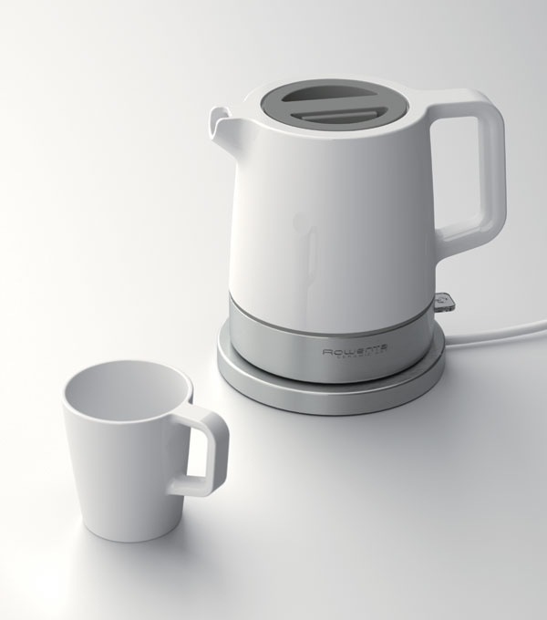
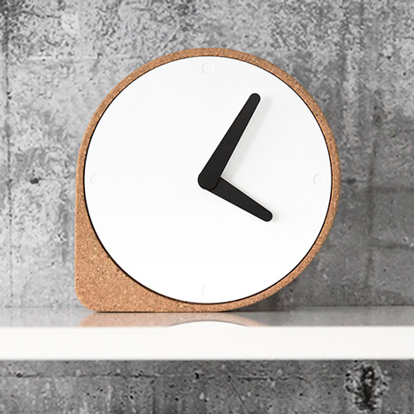
WHAT COMMON OBJECTS DO PEOPLE HAVE IN THEIR HOMES?
ONLY IN THE KITCHEN?
IN MULTIPLE ROOMS, BLENDS IN, WALL BASED ...

Slide 23
AND IF I MAKE IT A CLOCK…
I COULD CALL IT
‘POLITICKS.’
#JUST SAYIN’

Slide 24
THIS WEEK’S PLAN -
Finalise exactly ‘what it does’ and how
Figure out processing - rss feeds
Setup arduino with lcd screen
Build a tactile prototype using laser cutting, 3d printing etc
Add additional functions?
Improve on design!

